Slide 1

Workplace Safety Grant
Because Being Safe AT WORK IS NO accident !
MARYANN FALVEY, DIRECTOR OFFICE OF SAFETY

Slide 2
FY 26 Grant Application Announcement
The Office of Safety, will accept applications for the FY26 Workplace Safety Grant
For FOUR Weeks Only.
Application Period:
June 2,2025-June 30,2025
Applications will be considered on compellingness to meet grant objectives
Budget $800,000
Maximum Grant Request
$25,000
https://www.mass.gov/workplace-safety-grant-program

Slide 3
About the Workplace Safety Grant
The Workplace Safety Grant is issued under the provisions
M. G. L. c 23E § 3 and is administered by the Department of Industrial Accidents ,Office of Safety.
The grant program provides Massachusetts based employers of good standing with funding for employee training to prevent or redress a history of workplace injuries.
The maximum grant award is $25,000 per recipient.

Slide 4
“Must” Know List
Applicant organization’s employees must be covered by the Massachusetts Workers’ Compensation Act, M.G.L. c. 152.
This is a reimbursement program
Massachusetts based training providers must be used.
Training/s MUST relate to the work performed by the employee/s and address prevention of unhealthy working conditions and practices.
Training is tied to the Commonwealth’s fiscal year; all training MUST be completed by June 30th.
Invoices MUST be received by the Office of Safety by July 15th for each grant year
What you need to know

Slide 5
EXCLUSIONS
Costs incurred prior to the effective date of the contract.
Training for Police, State Police, Firefighters, State and Federal employees, and organizations covered by Jones/Longshore Act.
Costs for employee wages, stipends, or reimbursements for
parking and travel expenses, and re-training of employees previously trained under this grant on the same topic.
Developmental, compliance, policy/procedural programs, and emergency action planning programs.
Costs for office space, conference room rentals, utilities, communications, equipment (TVs, DVD players, computers, projectors, etc.), and other overhead expenses.
WHAT IS NOT INCLUDED ?

Slide 6
The Gathering
Organization’s legal name as listed with the Secretary of State. (d.b.a.) also
Organization’s Federal Employer Identification Number (FEIN).
Current number of Massachusetts employees in the organization
Contact information for the individual who is authorized to sign a contract to accept a grant.
Contact information for the individual administering the grant
Obtain a Department of Revenue (DOR) Certificate of Good Standing. To obtain the certificate, apply online at https://mtc.dor.state.ma.us/mtc
Obtain a Department of Unemployment Assistance (DUA) certificate of Unemployment Insurance Compliance. To obtain the certificate, apply at https://uionline.detma.org/Employer/Core/Login.ASPX
Obtain an assigned Vendor Number. To obtain a NEW Vendor Number, register on COMMBUYS. Register online at It takes just two simple steps: 1. Go to the COMMBUYS landing page at www.COMMBUYS.com and then follow these steps: 1)Select the first link titled REGISTER and complete registration. 2) You must register and select the United Nations Standard Products and Services Code (UNSPSC) 84-10-16. There is no cost.
Some of the information you’ll need to have handy in order to complete the application process

Slide 7
High Level - Grant Application Process
Grant Application - On line link through the Office of Safety
Gather the Necessary Information to Complete the Grant Application
Register Company in Portal & Receive Company ID
Follow Instructions Complete Part One: Application- Pages 1-8
Follow Instructions to Complete Part Two: Compliance and Contract Documents
Upload, DOR, DUA, EFT, W9, COMMBUYS, CASL
Submit Application- Receive Acknowledgment ( number in line)

Slide 8
Compliance & Procurement Check
Reference - Behind the Scenes
Office of Safety
Compliance & Procurement
W9
UI/UHI
DOR – Certificate of Good Standing
DIA/WCI
DIA/SWO
MassDOT
DCAMM
SCF
CASL
Fed SAM Debarment
SEC Annual Report
SEC Central Register
AGO Fair Labor
COMMBUYS

Slide 9
Sample
Hazards
Use Drop Down Features
ASBESTOS
CPR/AED
CTD’s
DEFENSIVE DRIVING
ERGONOMICS
FIRE ELECTRICAL
INJURY PREVENTION
LEAD HAZARDS
OSHA
RIGHT TO KNOW /HAZARD COMMUNICATION
Toxins
OTHER

Slide 10
Training Topics - 124 Listings
Active shooter/ Workplace de-escalation
Ariel lift
Asbestos
CPR/AED Chain Saw safety
Chemical/Biological Toxins
Right to know/ Haz communication
Confined space / Trench rescue
Crane and Rigger Training
Defensive driving
Ergonomics
First Aid
Fall Protection
Fire/ Electrical
Forklift
Injury Prevention
Lead hazards
Lock Out Tag Out
OSHA 10
OSHA 30
Safe Patient Lifting
Slips, Trips, and Falls
Spain/ Stain/ MSD, Repetitive/ Cumulative Trauma Disorders
Stress Management
Trenching, Excavation
Water Safety
Winter Driving
Other

Slide 12
Workplace Safety Grant
Because Being Safe AT WORK IS NO accident !
System Preview

Slide 13
KNOW BEFORE YOU BEGIN
About your organization. This information may include the organizational history, nature of the business, mission statement/goals and background.
Consortium details (if any). Must include the organizations full legal name, full legal address and (FEIN) number and numbers to be trained.
Demographics to include the current number of Massachusetts employees in the organization (full & part-time) and numbers to be trained.
A valid Certiﬁcate of Good Standing from the Massachusetts Department of Revenue (DOR) About your organization. This information may include the organizational history, nature of the business, mission statement/goals and background.
Consortium details (if any). Must include the organizations full legal name, full legal address and (FEIN) number and numbers to be trained.
Demographics to include the current number of Massachusetts employees in the organization (full & part-time) and numbers to be trained.
A valid Certiﬁcate of Good Standing from the Massachusetts Department of Revenue (DOR) https://mtc.dor.state.ma.us/mtc/_/ DO NOT pay for or obtain a certificated of good standing from the Secretary of States Office as it will not be accepted.
A Certiﬁcate of Unemployment Insurance Compliance from the Massachusetts Department of Unemployment Assistance (DUA) https://unemployment.mass.gov/Employers/_/
A COMMBUYS ID Number https://www.commbuys.com/bso/
Required contractual documents needed to submit your application ps://mdor.state.ma.us/mtc/_/ DO NOT pay for or obtain a certificated of good standing from the

Slide 14
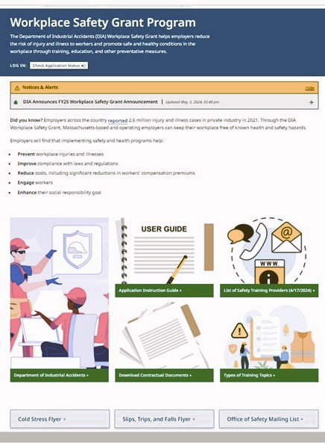
https://www.mass.gov/workplace-safety-grant-program

Slide 15
SAFETY TRAINING PROGRAM BUDGET NARRATIVE GUIDE (PAGE 7
Grants are awarded to provide direct worker safety training for employers and workers on the recognition, avoidance, and prevention of safety and health hazards in their workplaces. The purpose of training is to ensure that the employee will be able to perform the job correctly and safely. Identify and describe the injury history of the targeted occupation(s) (if any), or preventative safety issues you intend to address in this proposal. Here are some key elements to keep in mind that a training program narrative typically includes.
Consider and identify your company’s training needs.
Your goals and objectives should be clear and well defined.
Align your training to your business needs.
Once you have determined the needs of your organization, contact a Massachusetts training provider(s), and estimate cost for course fees.
Your training budget should identify the training topic(s), number of training classes, number of participants to be trained per class, name of the trainer(s) providing services and cost per class.

Slide 16
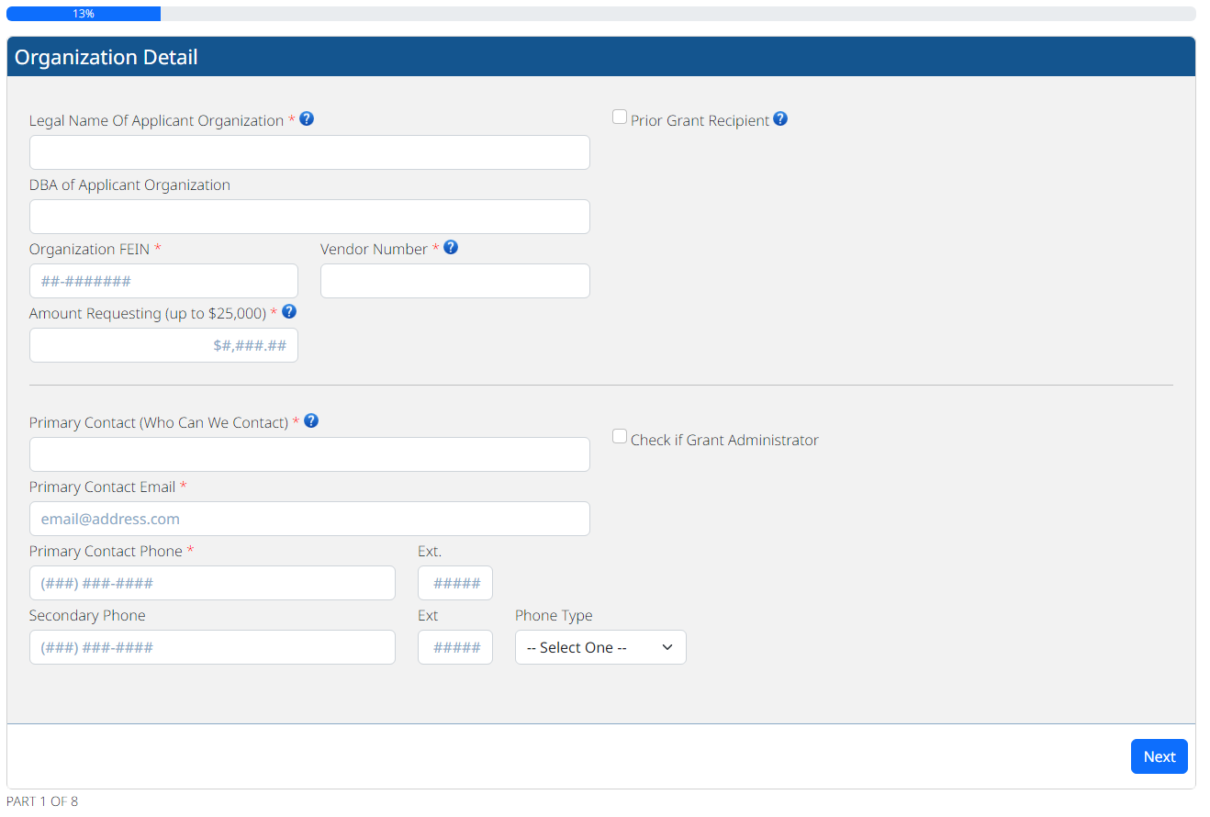

Slide 17
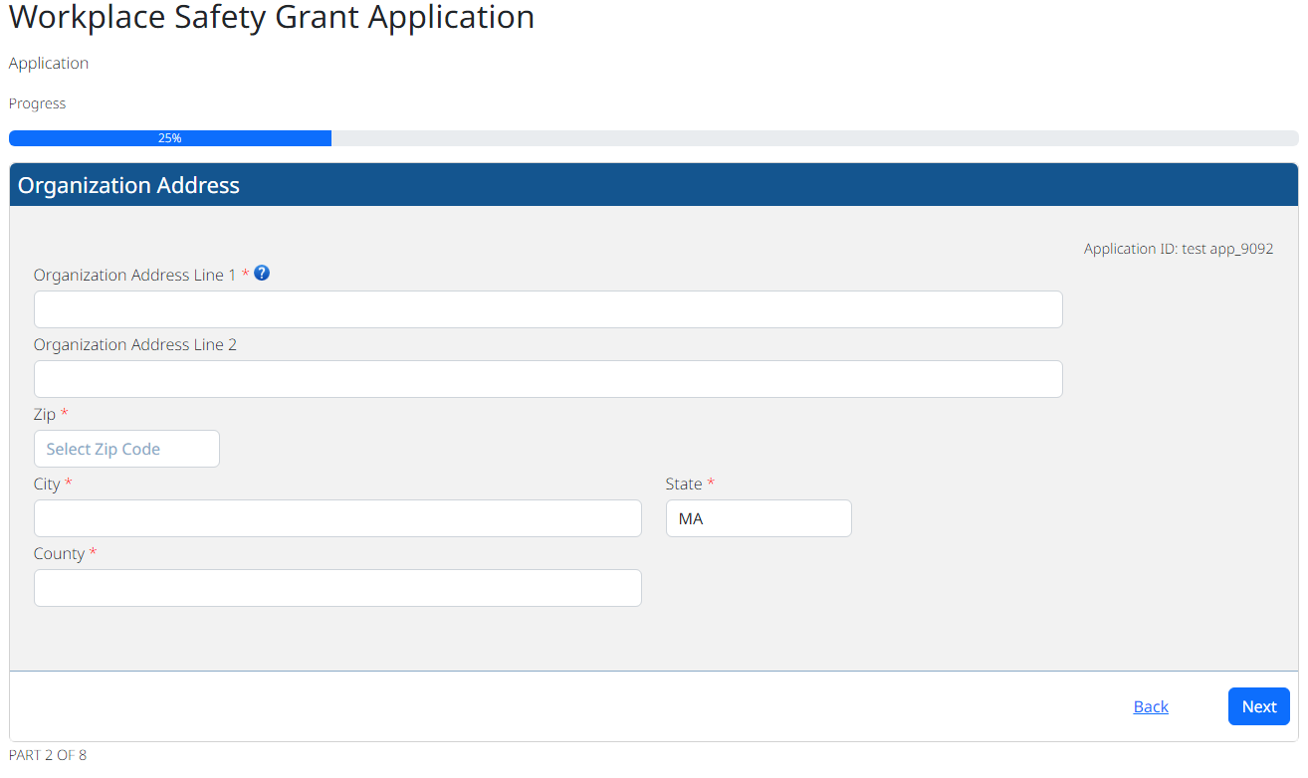

Slide 18
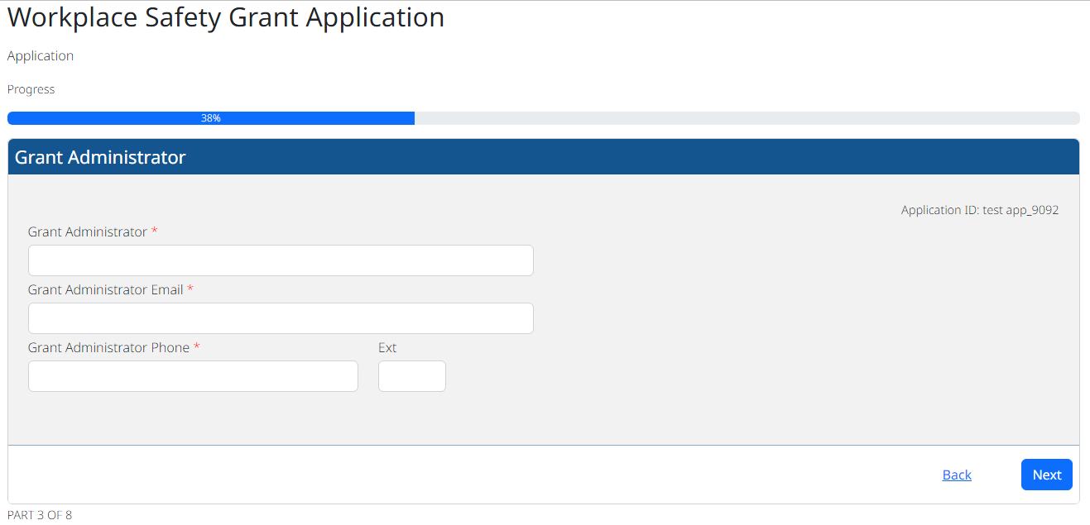

Slide 19
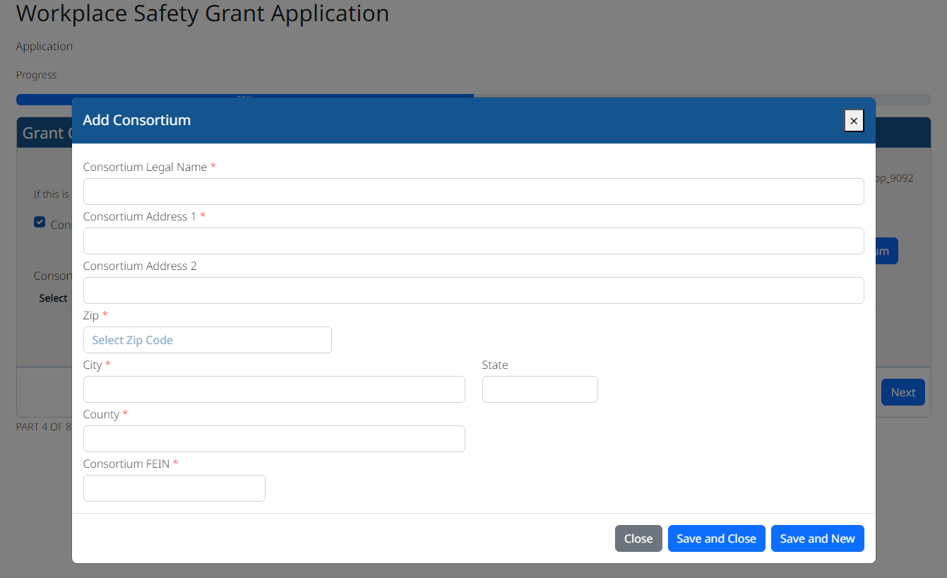

Slide 20
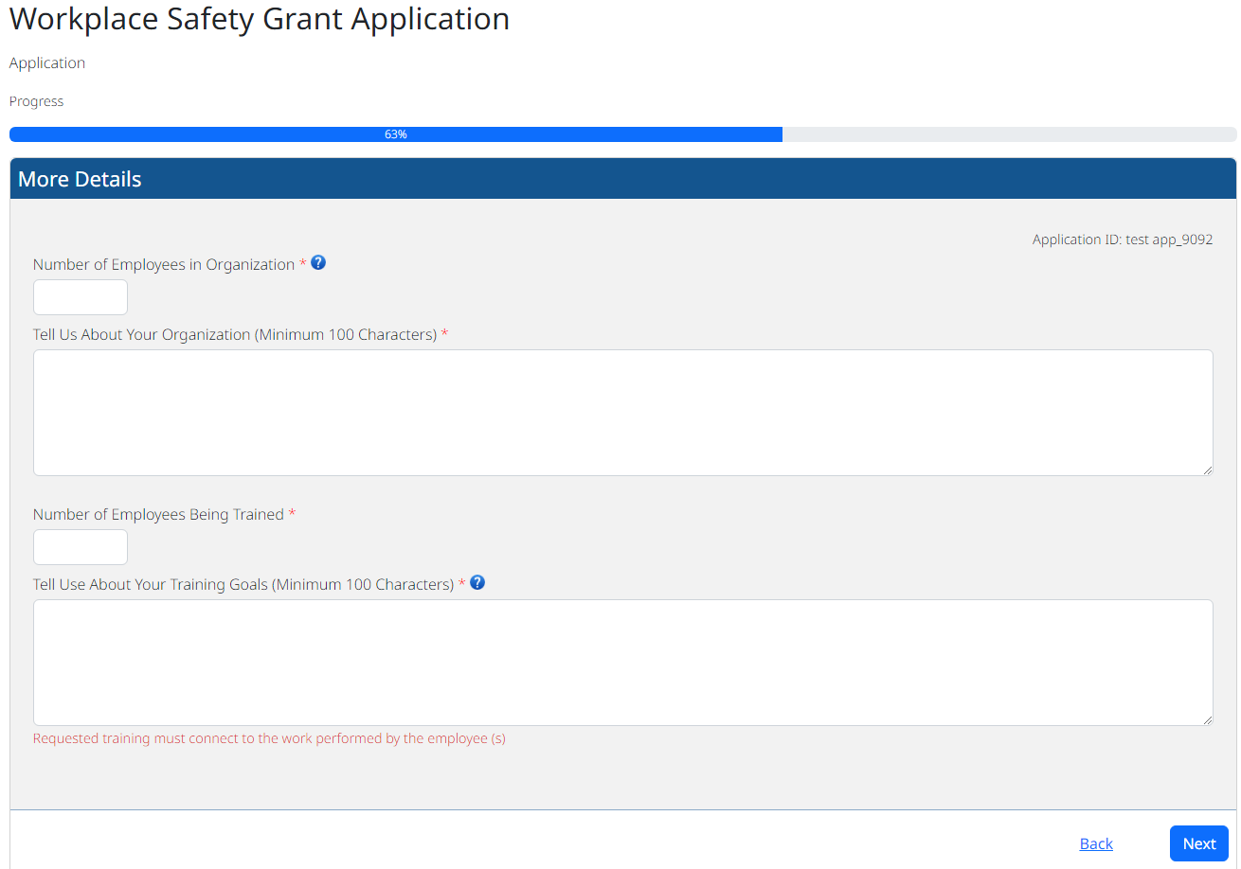

Slide 21
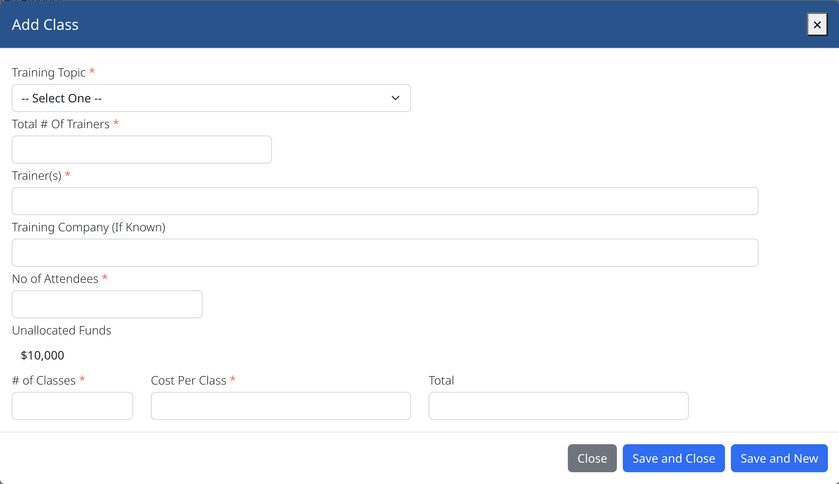
Craig P Statt

Slide 22
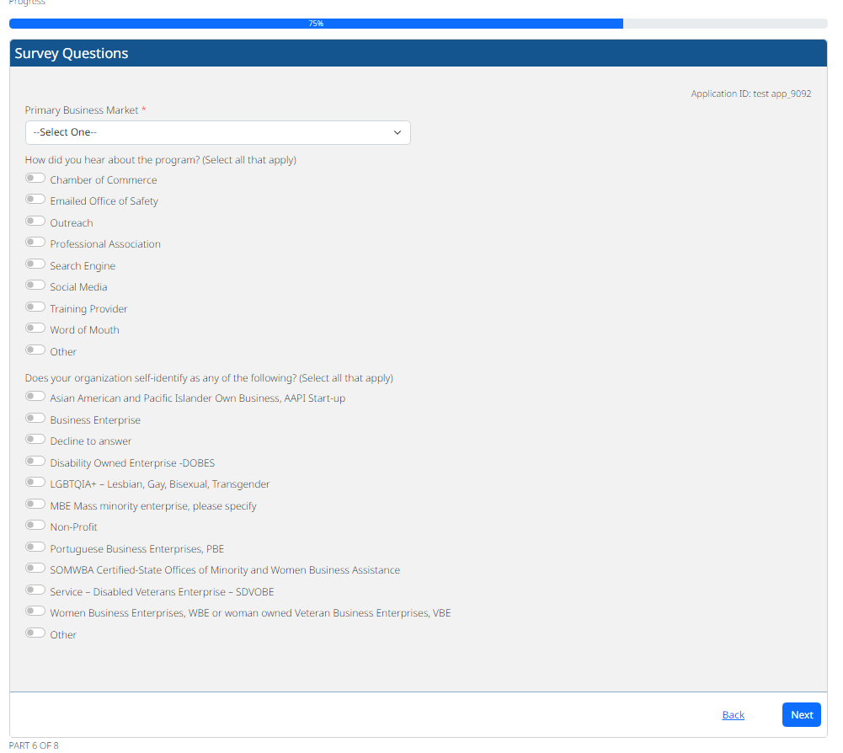

Slide 23
Training Classes
Craig P Statt

Slide 24
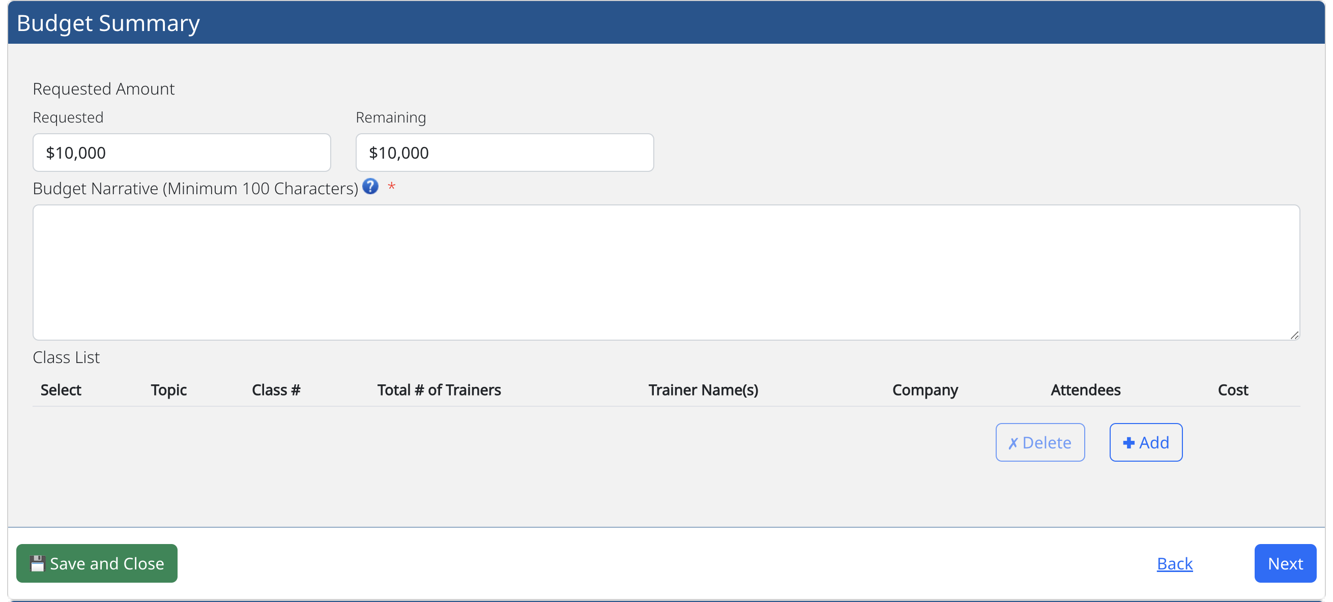

Slide 25
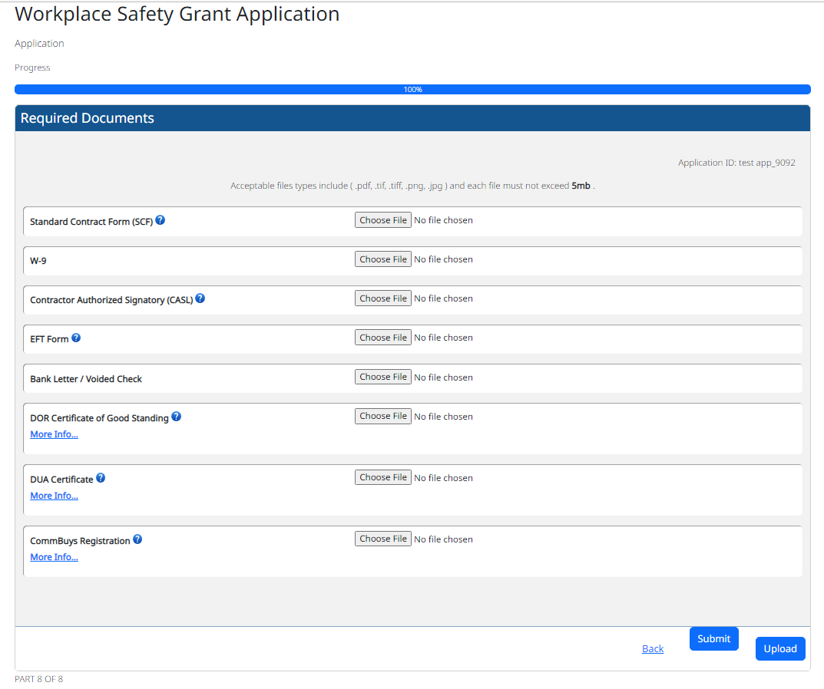

Slide 26
Contact
The Workplace Safety Grant
Because Being Safe AT WORK IS NO accident !
Questions ? - Email:safety@mass.gov

Slide 27
Workplace Safety Grant
Because Being Safe AT WORK IS NO accident !
thank you

